Slide 1
Agile Project Approach
A Module in Agile Fundamentals
Notes:
Hello, and welcome to The Agile Core, a module in Agile Fundamentals. This module is brought to you by ThoughtWorks Studios, makers of Mingle, Cruise, and Twist.
In this module, we will talk about some of the core concepts that make Agile what it is. Rather than talk about software, we’re going to talk about Bill…
NEXT SLIDE
The Agile Core: Story Based Development & Incremental Business Value
User Stories, Use Cases and Scenarios
Looking at the Big Picture – Is up front planning OK?
“Good Enough” Software
Release Early and Often
The story:
Actors and use cases – sterile
Actors are causal, use cases state results of that causality
Use cases are explanatory, and rarely include business value
Storytellers, customers, and stories – comes alive
Roles represent
Stories are demanding, as well as explanatory
Stories tell you why, as well as what
Stories do NOT tell you HOW
Storytellers share experience and needs
The Big Picture – is it possible to know everything up front?
has anyone had a house built? Remodeling done?
Zeno’s Paradox of the Dichotomy
http://en.wikipedia.org/wiki/Zeno%27s_paradoxes#The_dichotomy_paradox
“That which is in locomotion must arrive at the half-way stage before it arrives at the goal.” ~Aristotle, Physics VI:9, 239b10
“The perfect is the enemy of the good.” ~Voltaire
Incremental, with constant review
Fail fast, learn quickly, adapt - PDCA

Slide 2
Agile is…
Adaptive
Evolutionary
Collaborative
Just-in-time
Start with a plan
Notes:
Agile is not a “start coding and we can figure-out what the business wants later” approach.
Not a lot of published information on the entire agile project cycle, so planning and handover are often not considered
Plan well, and you can execute well
Lots of planning in agile – project level, release level, iteration level, daily through stand-up

Slide 3

Agile project lifecycle (TW style)
Initiation
Evolve / Handover (…)
Inception
Develop & deploy
Notes:
There is planning – Inception
2 – 4 weeks for a 4 – 6 month project
Flows, scenarios, stories
We need to prepare for Development – Initiation
Environment(s) set up
Narrative writing
Team processes
Develop & Deploy
Release working software
About 12 weeks of work
Common question?? How do I know how big the project is to determine how much time for Inception?
There has been a ‘Conceptualizing’ phase hopefully.
Experience. Relative sizing to other projects you’ve done.

Slide 4

Agile project lifecycle (TW style)
Many time-boxed iterations
Develop & deploy
Notes:
1 – 4 weeks
Shorter - more frequent change and increase transparency into issues and progress
Longer - accommodate the communication overhead required for larger, multi-team projects
Called a Release

Slide 5
The basics still apply
Analyze
Design
Code
Test
Deploy
Notes:
Repeating cycles of this stuff

Slide 6
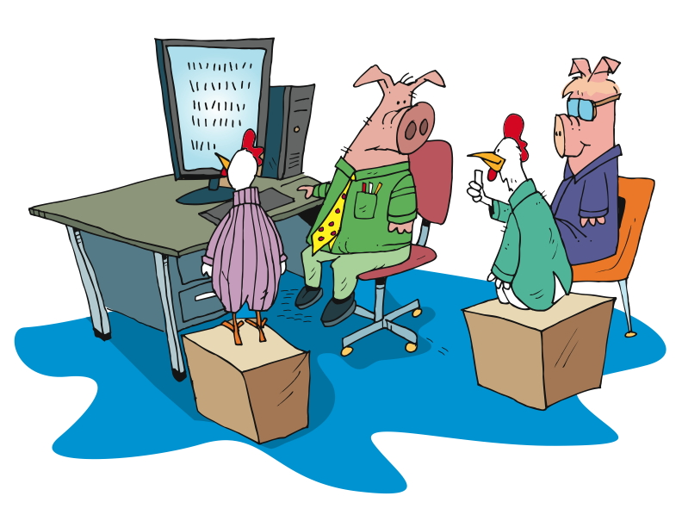
Agile project lifecycle (TW style)
Working software showcased to the business
Develop & deploy
Notes:
Talk about UAT – psychologically, people want to “kick the tires”

Slide 7
The flow
Daily stand-up
Story backlog
Prioritized subset
prepared for IKO
Iteration Kick-Off (IKO)
Showcase
Working software
Notes:
Story Backlog
List of stories for the entire project
Prioritized sub set
Prioritized for the next Iteration
Whole team
IPM
No waste
IKO
Clarify
Task
Estimate
Stand up
Short
Yesterday, today, blockers
Chickens and pigs
Showcases
Present working software
Sometimes give customer a play environment too
Customer gives feedback
New stories?
Re-plan?
Retrospective
Well, not so well
Constant improvement

Slide 8
The Team
Notes:
Who does what on an Agile team.

Slide 9
What does your team look like?
exercise
Break into groups of 4 or 5
What roles make-up your team?
Write each role on an index card.
What are their major responsibilities?
Where (physically) are these people?
How often do you communicate with them?
Write your information on the index card.
You may be asked to share your answers with the rest of the workshop
Notes:
We want to get people focusing on the entire build team, not just developers, QA’s, BA’s, etc.
This exercise is to identify the participants perception of “their” team, and how limited their view might be.

Slide 10
Team Composition Principles
Traditional
Check & Balance: conflict of interest between roles
Different focus: different roles
Agile
Check & Balance: built into practices so people can cooperate
Different focus: different ceremonies

Slide 11
Team Composition Principles
Traditional
Effectiveness: control performance reviews high utilization
Agile
Effectiveness: lifeboat principle mastery and purpose no multitasking 100% team membership

Slide 12
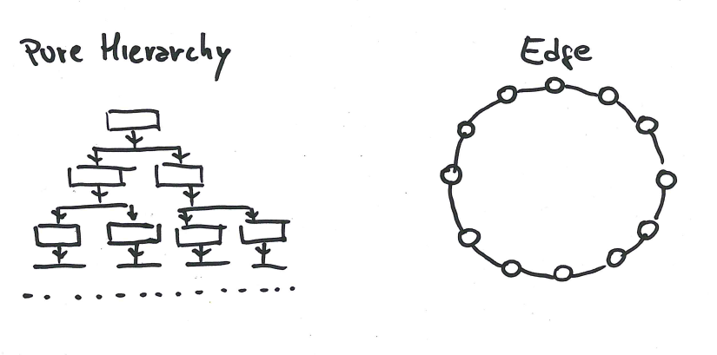
Teams Cooperation

Slide 13
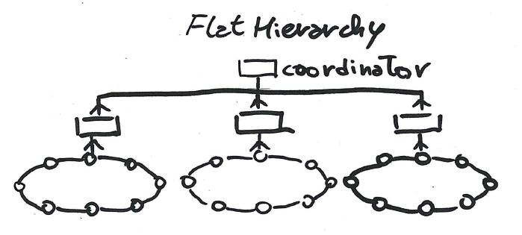
Teams Cooperation

Slide 14








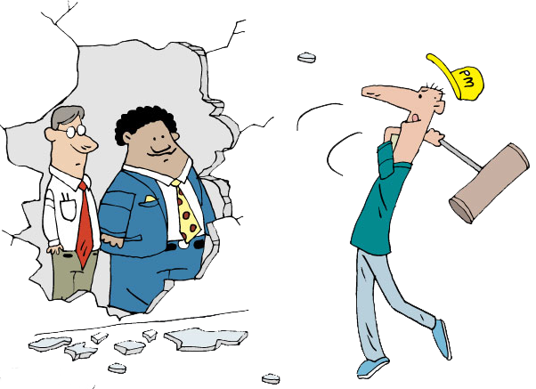






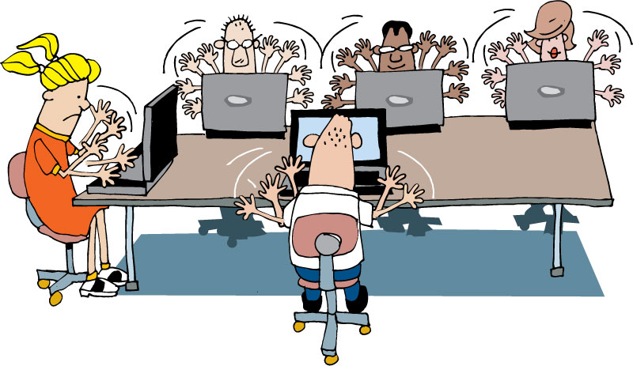


Indicative Team Composition
Architects, Process Specialists and SMEs
Security Architect
Agile
Project
Team
Program Manager
Coach
Infrastructure Delivery Mgr.
Architect
Tech Lead
Product Owner
IM
Project Stakeholder Board
Business
Analyst
PM
Tester
UX Designer
Project Owner / Sponsor
Developer
Core
Team
Other Business Representatives
Operations, Integration & Support
Database Administrator
Notes:
Having an understanding of the participants view of their team, explain the TW view of teams, especially the project core team.

Slide 15

Product Owner/Customer
Provides vision for the solution
Single point of escalation for prioritization

Slide 16

Business Analyst
Facilitates workshops
Understands the business needs
Focuses on business value
Manages requirements
Creates artifacts
Supports developers
Works with testers
Notes:
#1 responsibility is to truly understand the business needs, problems and..
Work with developers to propose solutions.
Facilitates sessions with business and stakeholders
Requirements gathering
Prioritization
Showcases
Requirements elicitation, elaboration,
Creates stories and development artifacts
Writes acceptance criteria with the business/customer and QA
Works with developers and testers to clarify stories

Slide 17

Iteration Manager / Scrum Master
Facilitates collaborative activity
Encourages and mentors
Carries water
Removes boulders
Notes:
PM is generally outward/management facing.
Budget to actuals
Steering committee, sponsor communication/meetings
Removes technical or resource obstacles
IM –[CLICK] Iteration Manager/Scrum Master can be a different person or the same person as the PM
is generally inward/team facing.
Facilitates team meetings – standups, IPM/IKO, retrospectives, showcase (w BA)
Tracks velocity, capacity
Manages the backlog. Works with customer and BA to prioritize new stories
Maintains card wall and other project radiators

Slide 18

Developer
Creates working software
Adheres to coding standards
Practices TDD
Collaborates with BA and Testers
Notes:
Coding standards:
Consistent style and format for source code, either standard conventions specified by the language vendor (e.g. The Code Conventions for the Java Programming Language, recommended by Sun) or custom defined by the team
Design patterns (avoid anti-patterns) and principles, such as SOLID

Slide 19

Quality Assurance Analyst (Tester)
Declares ‘Done’
Creates test plans
Performs various tests
Updates quality metrics

Slide 20

User Experience Analyst
Facilitates workshops
Defines usability
Conducts usability testing
Usability =
Learnability
Efficiency
Memorability
Errors
Satisfaction
Notes:
Facilitates sessions to design the most ‘usable’ design for all users
Considers different roles, users
Usability is defined by 5 quality components:
Learnability
Efficiency
Memorability
Errors
Satisfaction

Slide 21
Indicative Team Composition
Extended
Team
Architects, Process Specialists and SMEs
Security Architect
Agile
Project
Team
Program Manager
Coach
Infrastructure Delivery Mgr.
Architect
Tech Lead
Product Owner
IM
Project Stakeholder Board
Business
Analyst
PM
Tester
UX Designer
Project Owner / Sponsor
Developer
Other Business Representatives
Operations, Integration & Support
Database Administrator
Notes:
Having an understanding of the participants view of their team, explain the TW view of teams, especially the project core team.

Slide 22

Agile Project Manager
The Agile PM focuses out
Responsible for Budget & Staffing
Coordinating with external teams and stakeholders
Notes:
Bottom line, PM is outward facing.
Supporting teams – environments, deployments, data, documentation,
Stakeholders
Executive or Steering committees
Low: 1 min
High: 3 min

Slide 23

Business Stakeholders
Represents a particular area of the business
Participates in key activities
Responds promptly
Notes:
Represents a particular area of the business (e.g. sales / marketing, legal / compliance, etc.) during the lifetime of the project
Participates in key activities, e.g. inception, release planning, showcases, etc.

Slide 24



Implementation Stakeholders
Represents areas of the delivery team
Participates in key activities
Responds promptly
Notes:
Represents a particular area of the wider delivery team (e.g. Operations)
Participates in key activities, e.g. inception, release planning, showcases, etc.

Slide 25
What responsibilities of each Role?

Slide 26
Questions?
Notes:
What we’ve done……
Seen how best practices address traditional project challenges
Learned the process
Met the team

